Slide 1
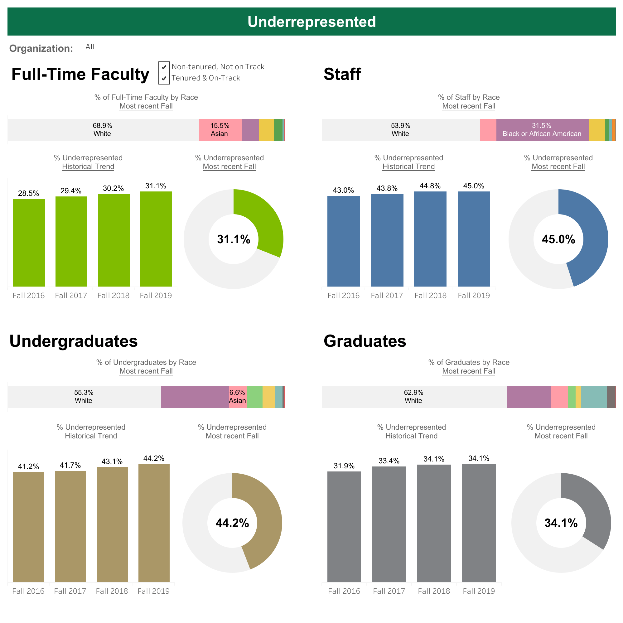
The Tableau HR Scorecard: Measuring Success in Talent Management

Slide 2
DEPARTMENT OF PHYSICS V.O.CHIDAMBARAM COLLEGE THOOTHUKUDI
SUBMITTED BY:
MENTOR: Dr. S. SUBRAMANIAN
(ASSISTANT PROFESSOR)
RATHIES M 20212231522131
SATHISH KUMAR C 202122315122137
SURYA AAKASH M 20212231522144
MADASAMY M 20212231522120

Slide 3
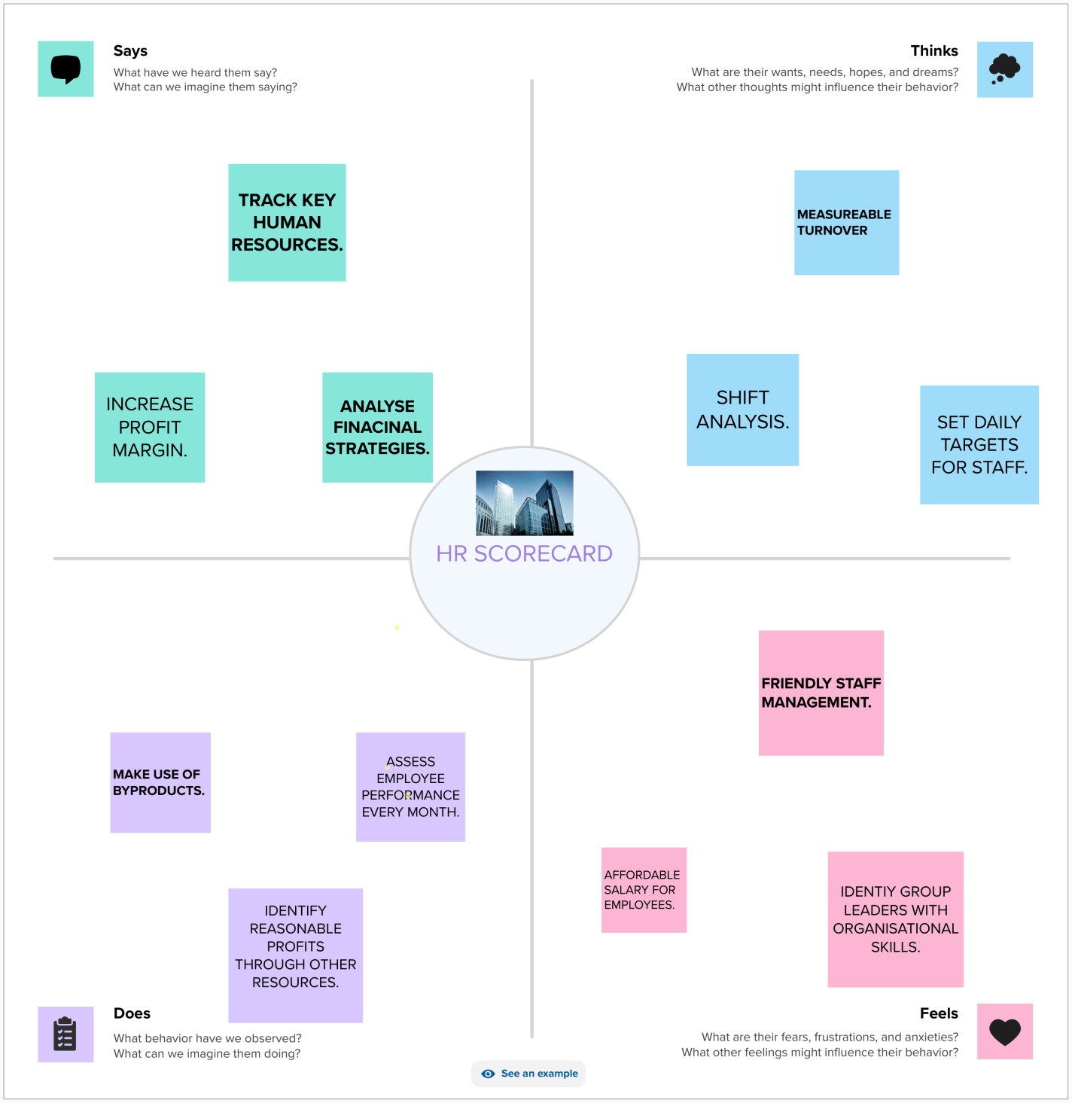
EMPATHY MAP

Slide 4
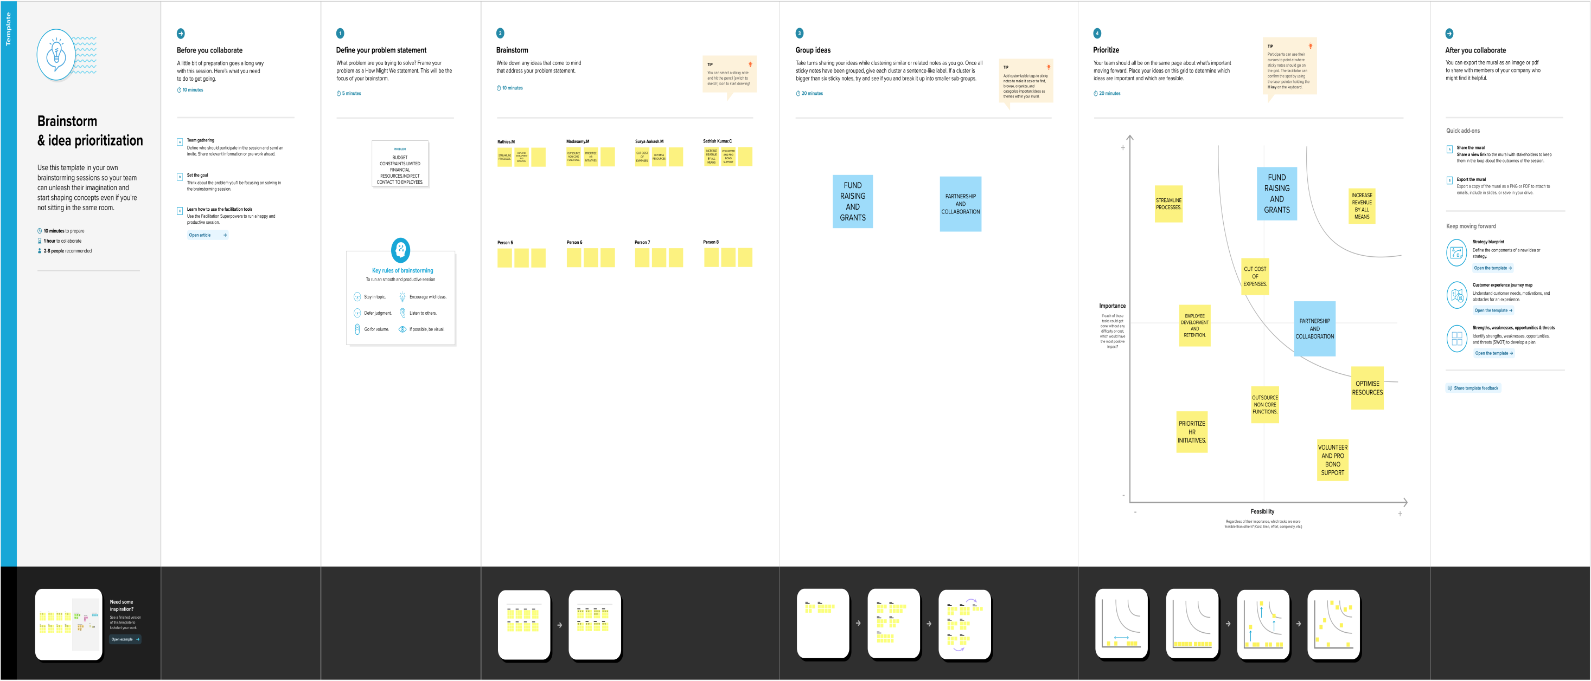
BRAINSTORMING AND IDEA PRIORITIZATION

Slide 5
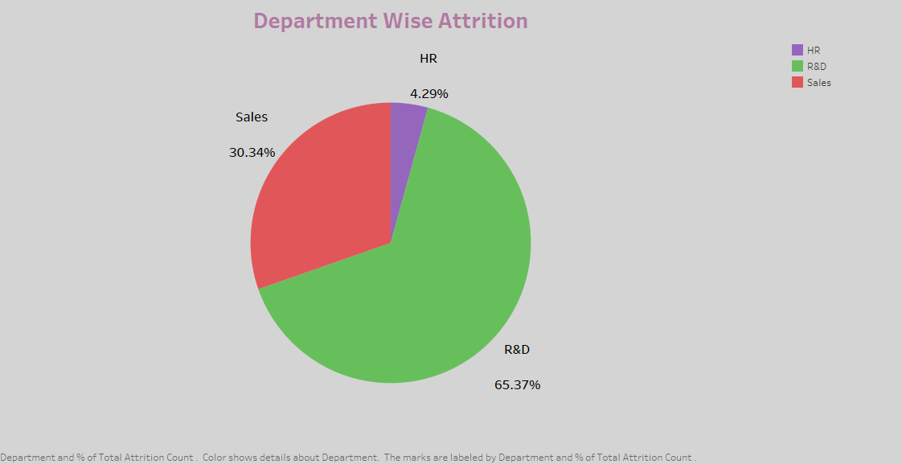

Slide 6
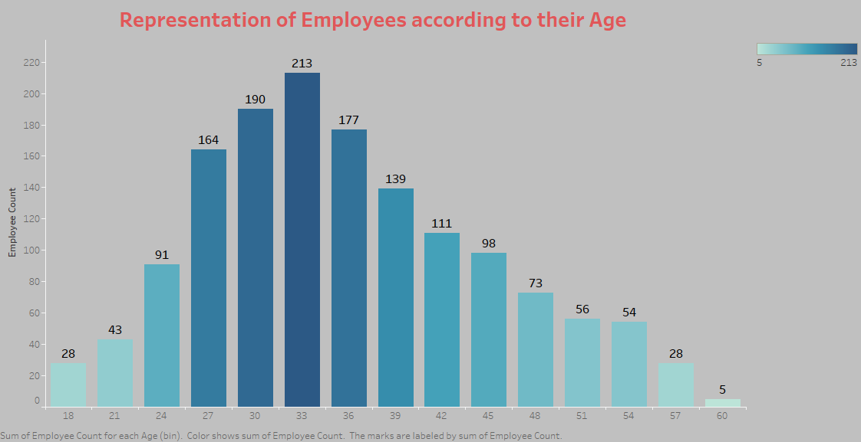

Slide 7
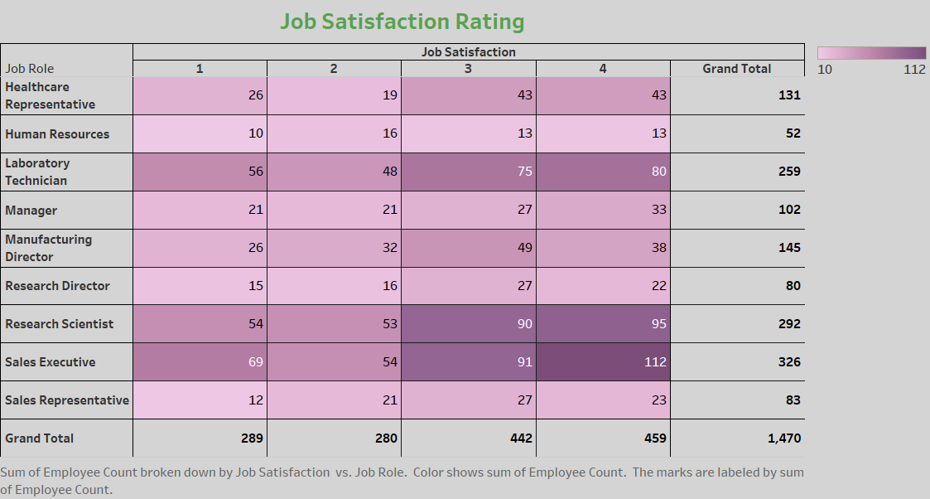

Slide 8
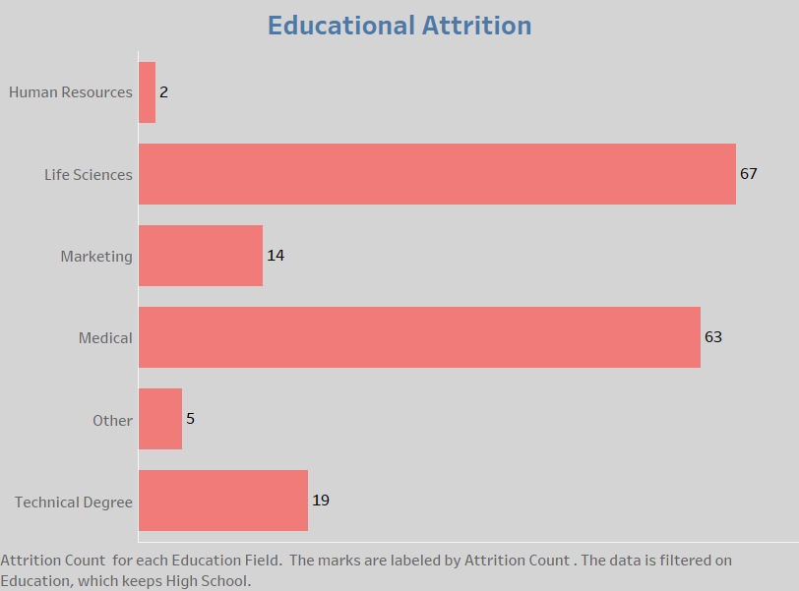

Slide 9
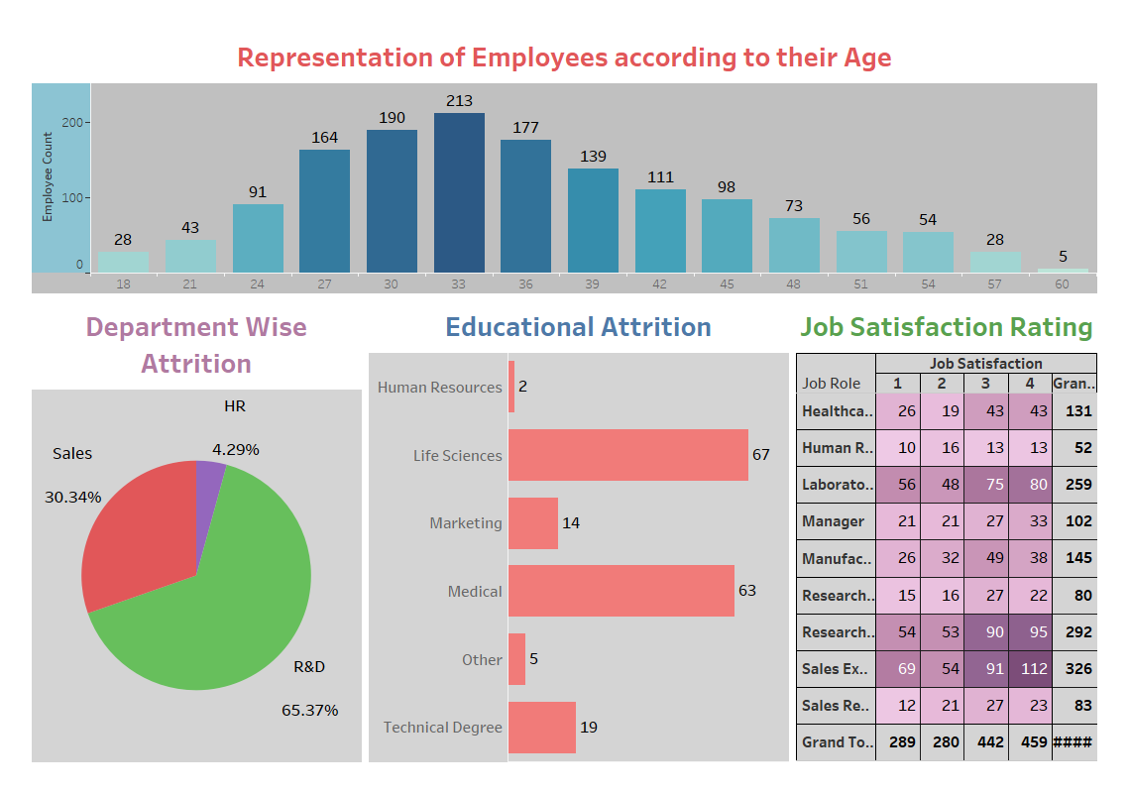

Slide 10
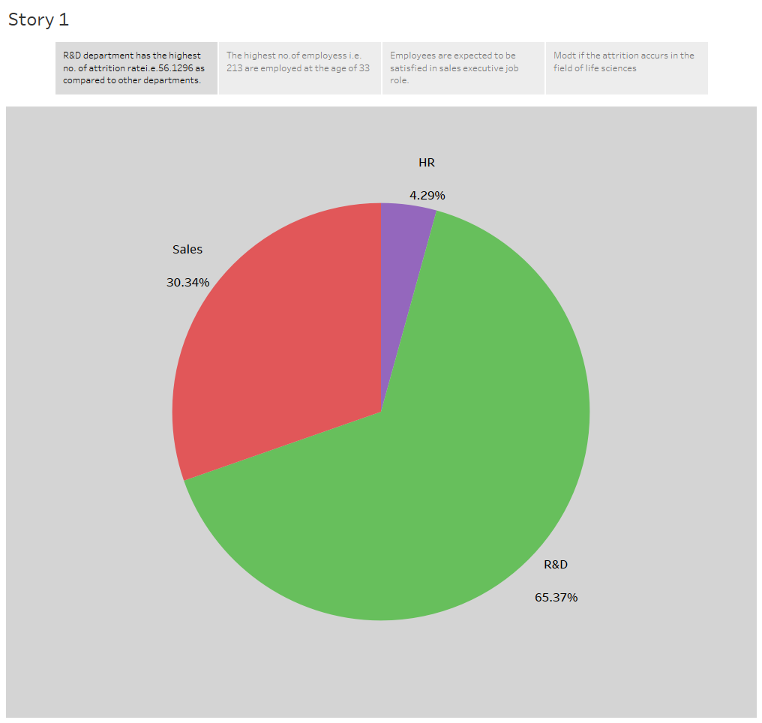

Slide 11
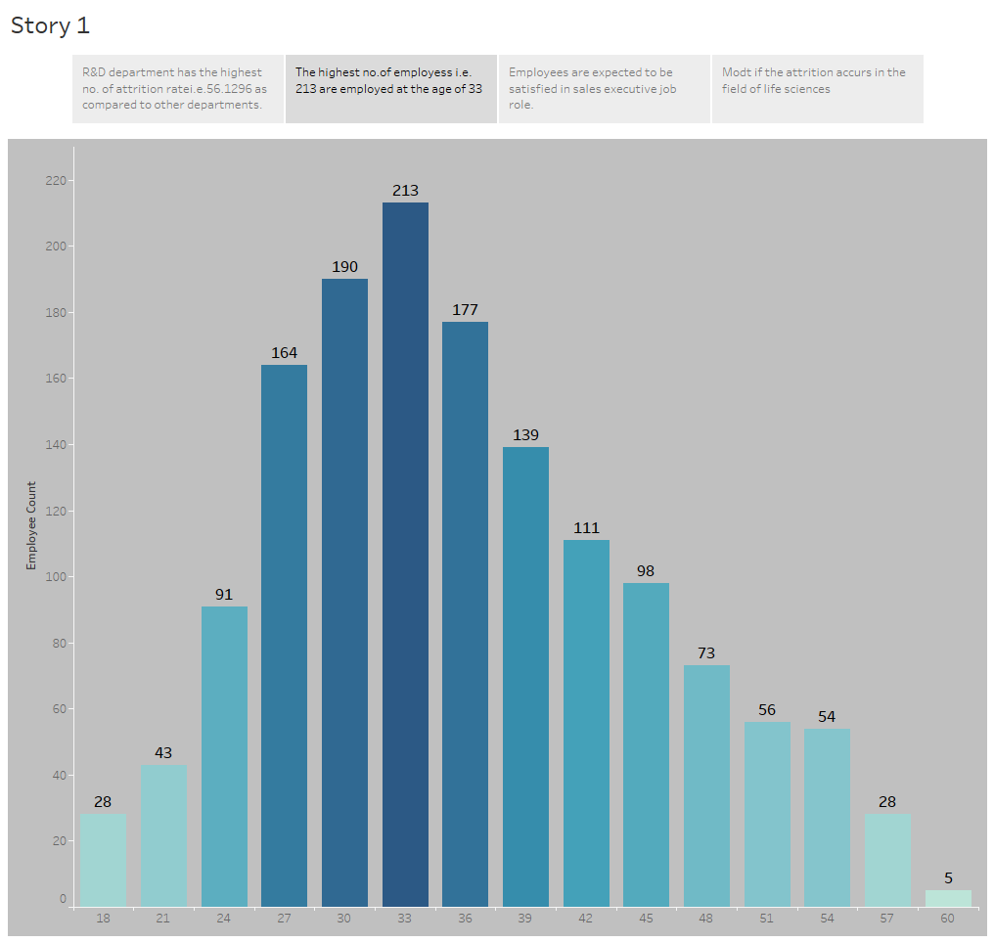

Slide 12
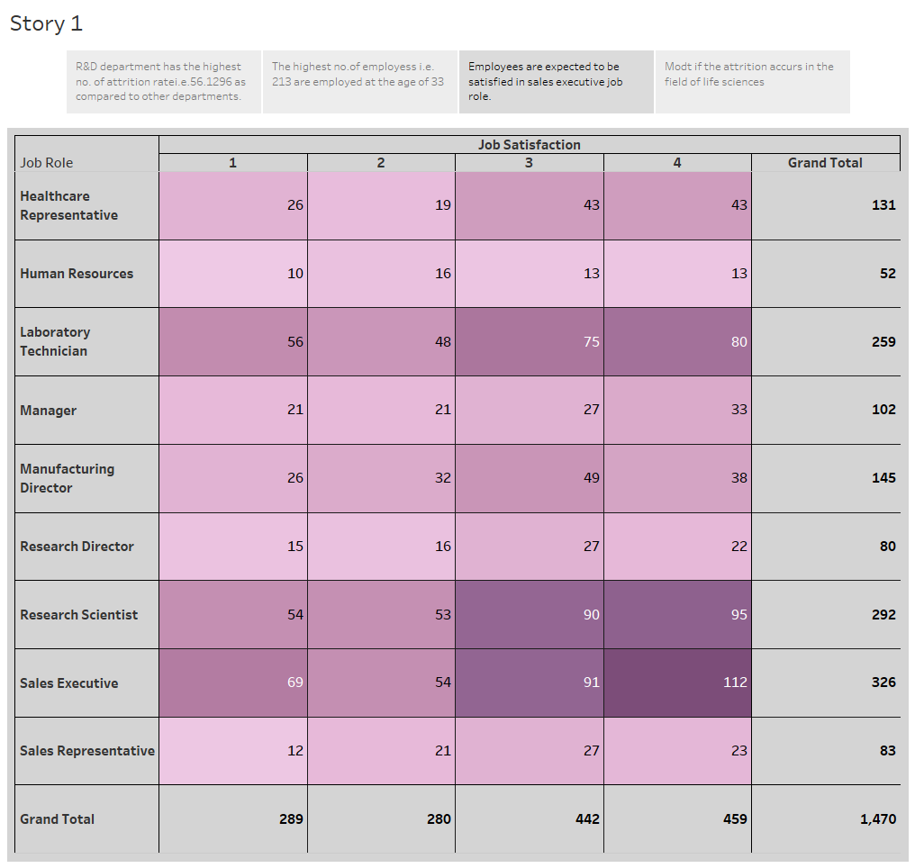

Slide 13
